Slide 1
Helical Resonator
November 29 2017
Li He

Slide 2
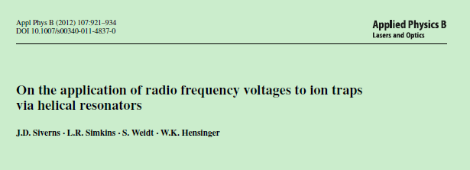
Outline
Why we need a resonator
What is helical resonator
How to make a helical resonator

Slide 3
Why

Slide 4
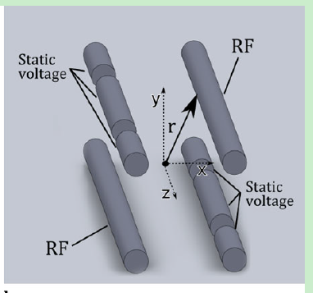


High Voltage and no noise
Paul Trap, use RF field to trap ions
Pseudopotential：
Secular motion frequency：
Need RF with High voltage and narrow band width
1. Deep trap depth- strong trap strenth
2. Big secular motional frequency- fast gate
Low noise-low heating rate
Amplifier has big noise, so cannot be uesed

Slide 5
what

Slide 6
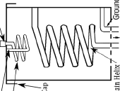
Helical Resonator
RF source

Slide 7
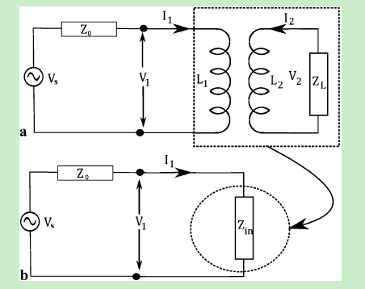

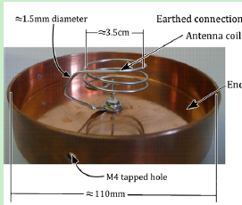
Circuit-impedance matching to source
Antenna
Resonator
trap
source
The impedance of source is 50Ohm
For getting minimum reflection power
The load impedance should be 50OHm
N : how many circle
T: pitch distance
A: section
We can modulate the parameter of antenna
To match 50 Ohm impendance

Slide 8
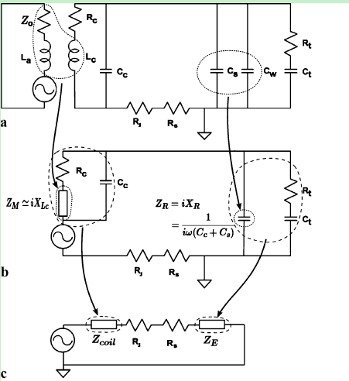
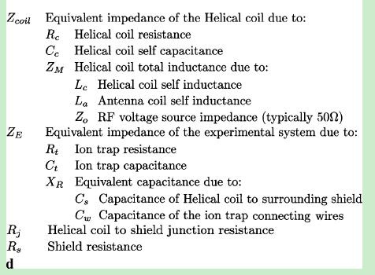
Circuit
Source+
antenna
Resonator
Trap

Slide 9
Serial RLC circuit-Resonat frequency
Impedance:
The circuit has minimum impedance then maximum current
So it’s the resonant frequency of the circuit
For
The resonator situation need the circuit is resistive

Slide 10
Q factor
Energy stored in either inductor or capacitor
Energy dissipated on resistance
so
With

Slide 11


Real case
The C L R is the combination of
A lot of C L R

Slide 12

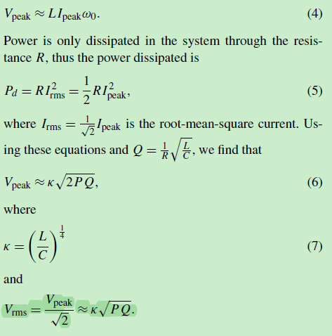
Amplifier effect
The source voltage is low
When resonance The voltage on The inductor
Equals to The one on Trap capacitor
(The resistance is very low )

Slide 13
How

Slide 14
From Q factor
Indicated by The Q we need
Low R
High Ratio of L/C

Slide 15
具体计算方法
通过经验公式可以计算出不同尺寸结构的resonator的R L C
可以通过所需要的共振频率，像最大Q值以及合理制作方案，去优化结构参数

